Slide 1

Amazon US Customer Reviews
Tinghui Xu, Ouyang Xu, Bowen Tian, Yijin Guan, Yifan Du

Slide 2

Intoduction
Amazon is the online retailer with the largest variety of products in the world. It’s meaningful for either customers or the business owners to know more about the reviews of the items. Our main goal is to explore which aspects are mostly mentioned. This can help sellers improve their stars. So we use CHTC to find the relationship between the high frequency words and rating stars.

Slide 3
Data Description
Source : Kaggle
https://www.kaggle.com/cynthiarempel/amazon-us-customer-reviews-dataset
Reviews of products of six categories (6 tsv files):
Camera
Book
Digital Video Download
Electronics
Mobile Apps
Digital Ebook

Slide 4
Variable Names | Description
marketplace | 2 letter country code of the marketplace where the review was written.
customer_id | Random identifier that can be used to aggregate reviews written by a single author.
review_id | The unique ID of the review.
productid | The unique Product ID the review pertains to. In the multilingual dataset the reviews for the same product in different countries can be grouped by the same productid.
product_parent | Random identifier that can be used to aggregate reviews for the same product.
product_title | Title of the product.
product_category | Broad product category that can be used to group reviews.
star_rating | The 1-5 star rating of the review.
helpful_votes | Number of helpful votes.
total_votes | Number of total votes the review received.
vine | Review was written as part of the Vine program.
verified_purchase | The review is on a verified purchase.
review_headline | The title of the review.
review_body | The review text.
review_date | The date the review was written.

Slide 5
Data Processing
split.sh: to split 6 tsv files into tens of small tsv files, each 100MB.
checklist.sh: to find all the files that split from raw data and compile the file names to a list.
word_freq.R/.sh: to calculate on these files in parallel and count the word frequency.
If without parallel calculation, the word segmentation operation will take up a lot of memory and run for a long time

Slide 6
Data Processing
Example:
Split the camera.tsv (1.1GB) into 11 small tsv files.
Run word_freq_array_camera.sh to launch 11 small jobs. Each job does the tokenization and lemmatization to each csv file, and then calculates the frequency of each word, returning a csv file with Column word, star_ratings, and frequency.

Slide 7
Data Processing
Text Preprocessing
Remove all of the punctuation and some html elements like <br/> and &#34;.
Turn each and every letter to lower-case letter and do lemmatization, which can transform words like ‘swims’, ‘swam’, ‘swimming’ to ‘swim’.
Do tokenization to separate the strings into single words.
Remove all the stop words to get our word boxes.
Example:
We split the camera.tsv (1.1GB) into 11 small tsv files.
After that, we run word_freq_array_camera.sh to launch 11 small jobs. Each job does the tokenization and lemmatization to each csv file, and then calculates the frequency of each word, returning a csv file with Column word, star_ratings, and frequency.
Then, a bash file named merge.sh merges all these csv files about camera into one csv file.

Slide 8
Data Processing
Computation for words frequency
Example:
We split the camera.tsv (1.1GB) into 11 small tsv files.
After that, we run word_freq_array_camera.sh to launch 11 small jobs. Each job does the tokenization and lemmatization to each csv file, and then calculates the frequency of each word, returning a csv file with Column word, star_ratings, and frequency.
Then, a bash file named merge.sh merges all these csv files about camera into one csv file.
Group our word boxes to get words frequency results.
Extract top 2000 words in each split file and merge them into one .csv file.
Select all the nouns from the words we get.
Do these on each of the 6 sub files.

Slide 9
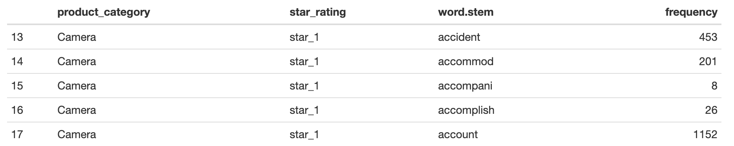
Computation for words frequency with star rating
Data Processing
Example:
We split the camera.tsv (1.1GB) into 11 small tsv files.
After that, we run word_freq_array_camera.sh to launch 11 small jobs. Each job does the tokenization and lemmatization to each csv file, and then calculates the frequency of each word, returning a csv file with Column word, star_ratings, and frequency.
Then, a bash file named merge.sh merges all these csv files about camera into one csv file.
Part of our original result

Slide 10
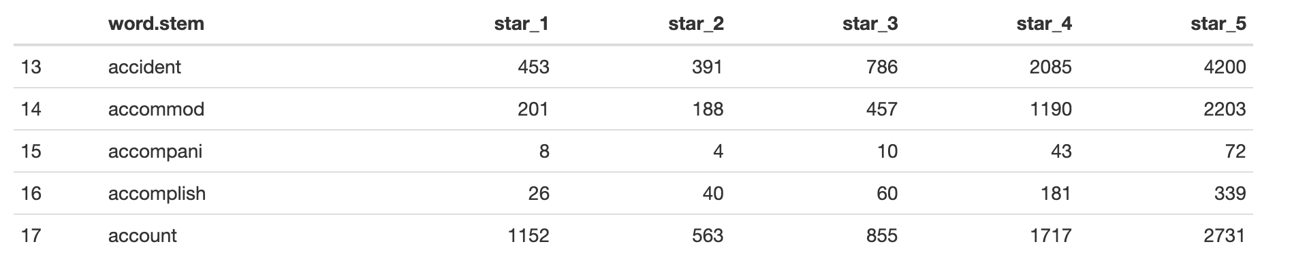
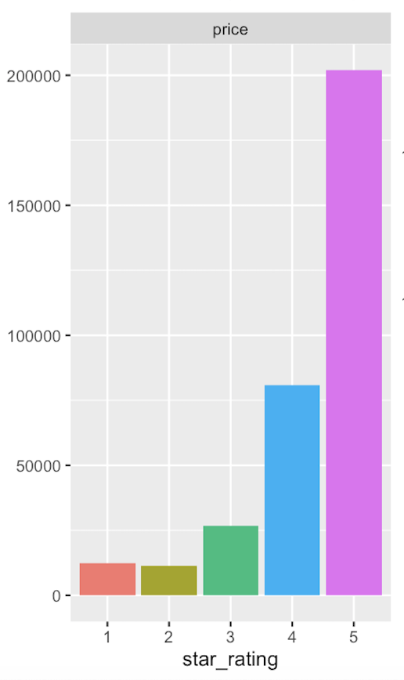
Word frequency v.s. Star rating plot
Part of our transformed result structure
Data Processing
Example:
We split the camera.tsv (1.1GB) into 11 small tsv files.
After that, we run word_freq_array_camera.sh to launch 11 small jobs. Each job does the tokenization and lemmatization to each csv file, and then calculates the frequency of each word, returning a csv file with Column word, star_ratings, and frequency.
Then, a bash file named merge.sh merges all these csv files about camera into one csv file.
An example:

Slide 11
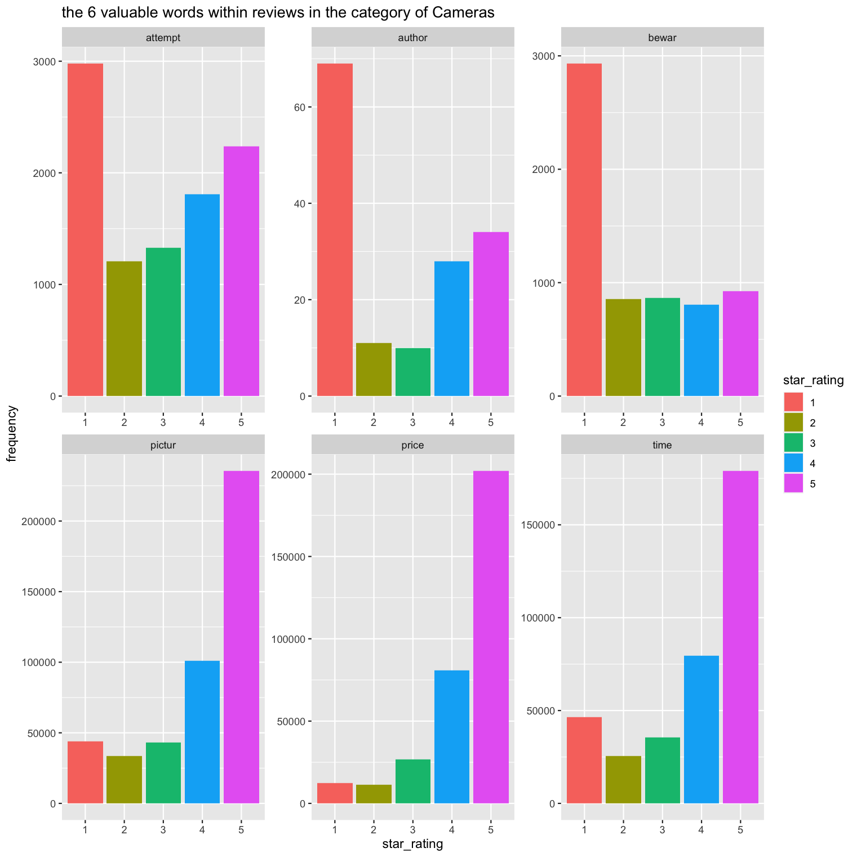
Conclusion
Data Processing
Example:
We split the camera.tsv (1.1GB) into 11 small tsv files.
After that, we run word_freq_array_camera.sh to launch 11 small jobs. Each job does the tokenization and lemmatization to each csv file, and then calculates the frequency of each word, returning a csv file with Column word, star_ratings, and frequency.
Then, a bash file named merge.sh merges all these csv files about camera into one csv file.

Slide 12
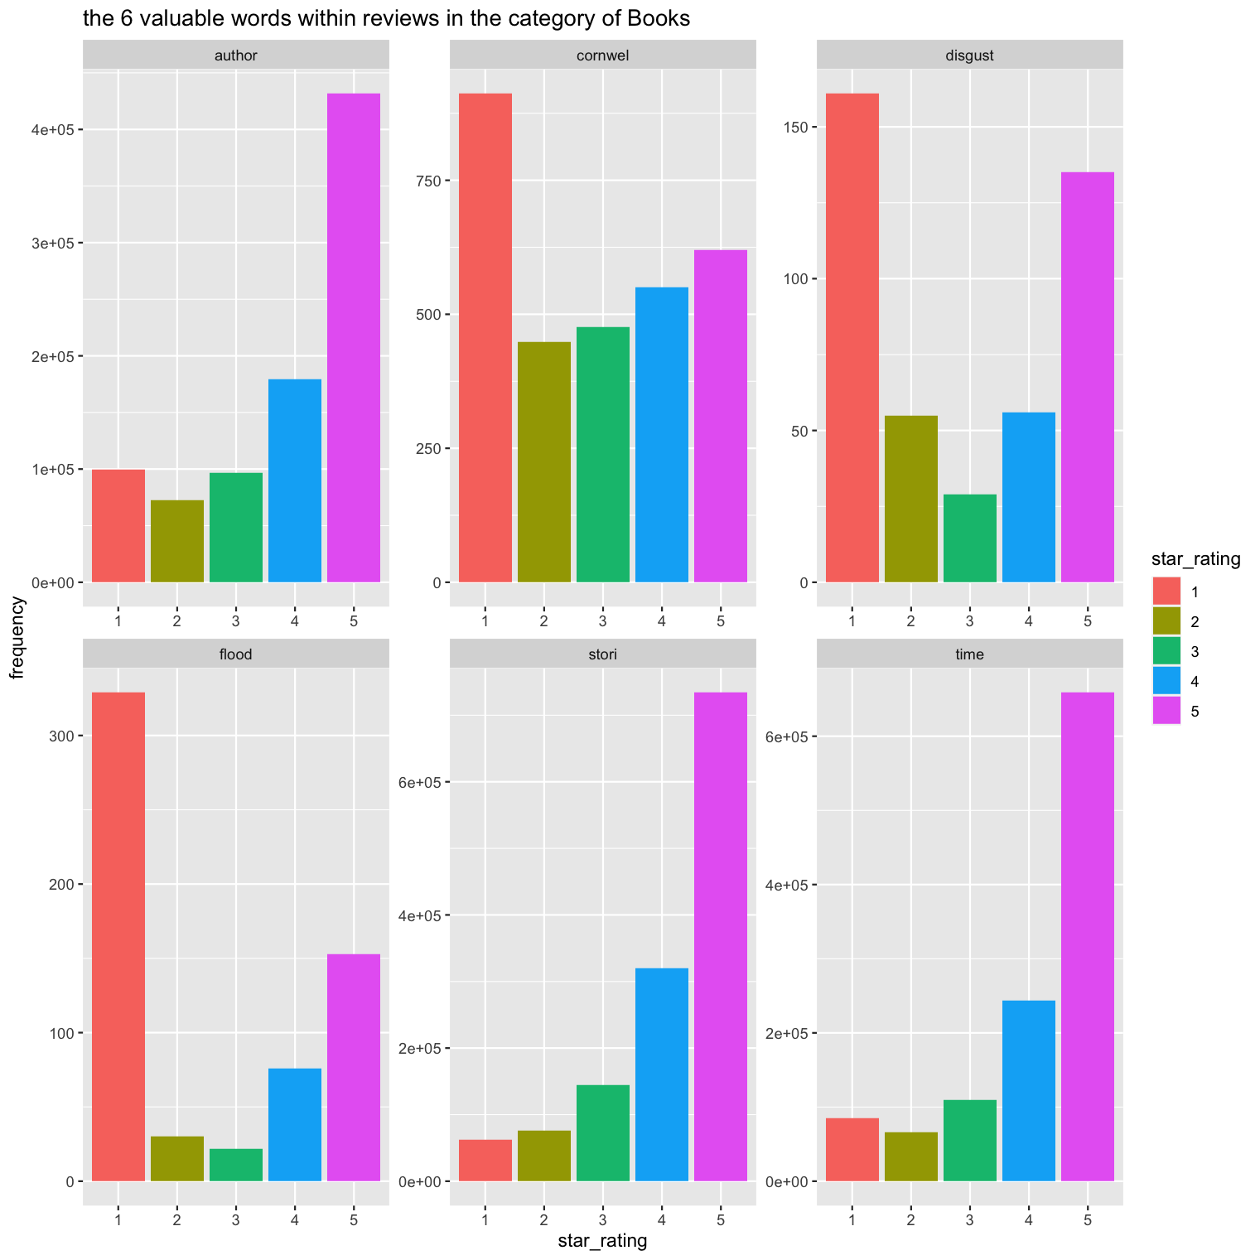
Conclusion
Data Processing
Example:
We split the camera.tsv (1.1GB) into 11 small tsv files.
After that, we run word_freq_array_camera.sh to launch 11 small jobs. Each job does the tokenization and lemmatization to each csv file, and then calculates the frequency of each word, returning a csv file with Column word, star_ratings, and frequency.
Then, a bash file named merge.sh merges all these csv files about camera into one csv file.

Slide 13
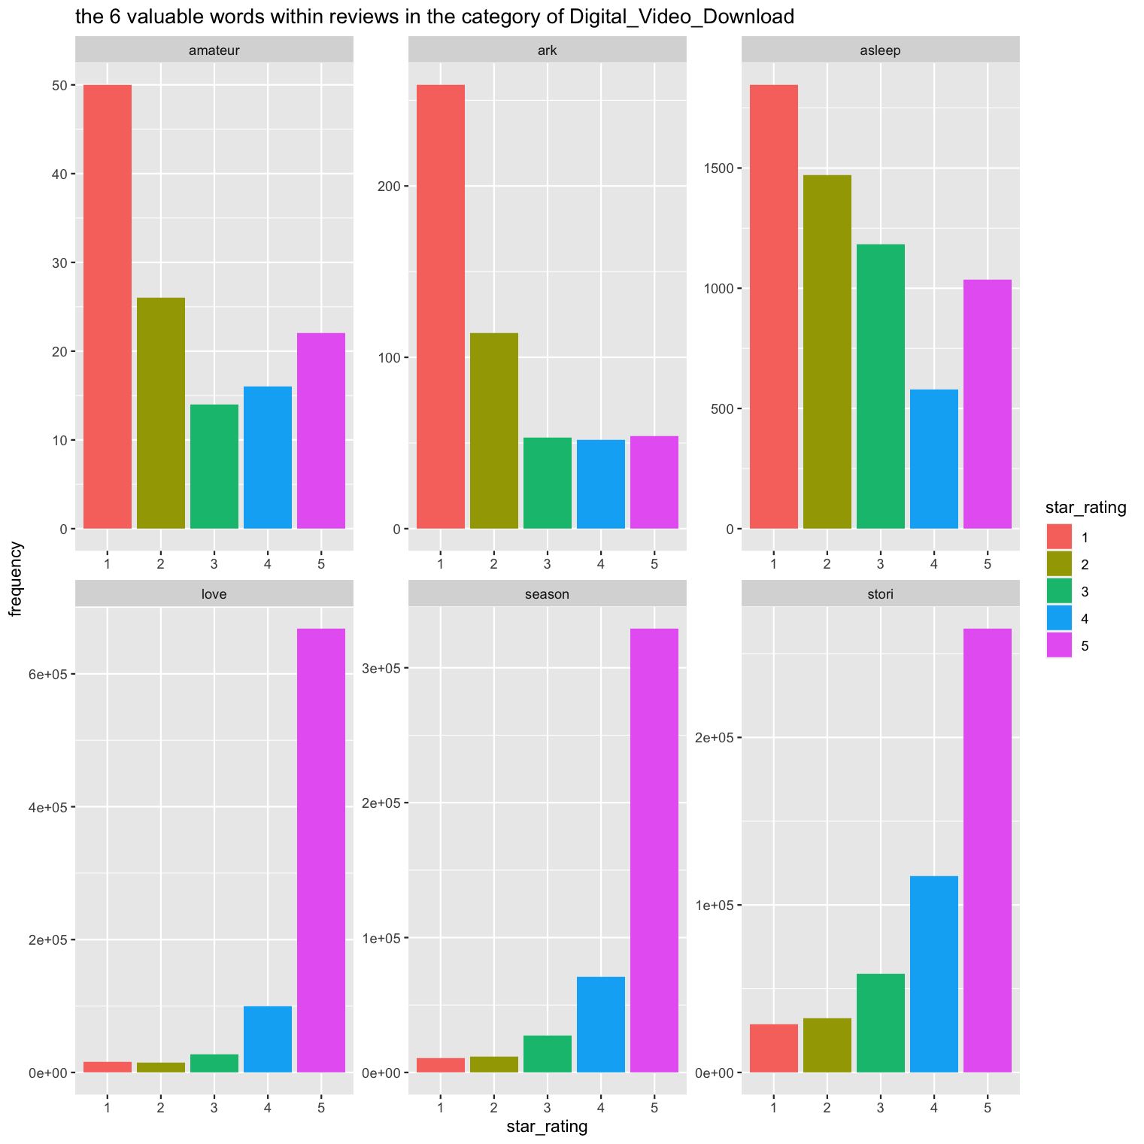
Conclusion
Data Processing
Example:
We split the camera.tsv (1.1GB) into 11 small tsv files.
After that, we run word_freq_array_camera.sh to launch 11 small jobs. Each job does the tokenization and lemmatization to each csv file, and then calculates the frequency of each word, returning a csv file with Column word, star_ratings, and frequency.
Then, a bash file named merge.sh merges all these csv files about camera into one csv file.

Slide 14
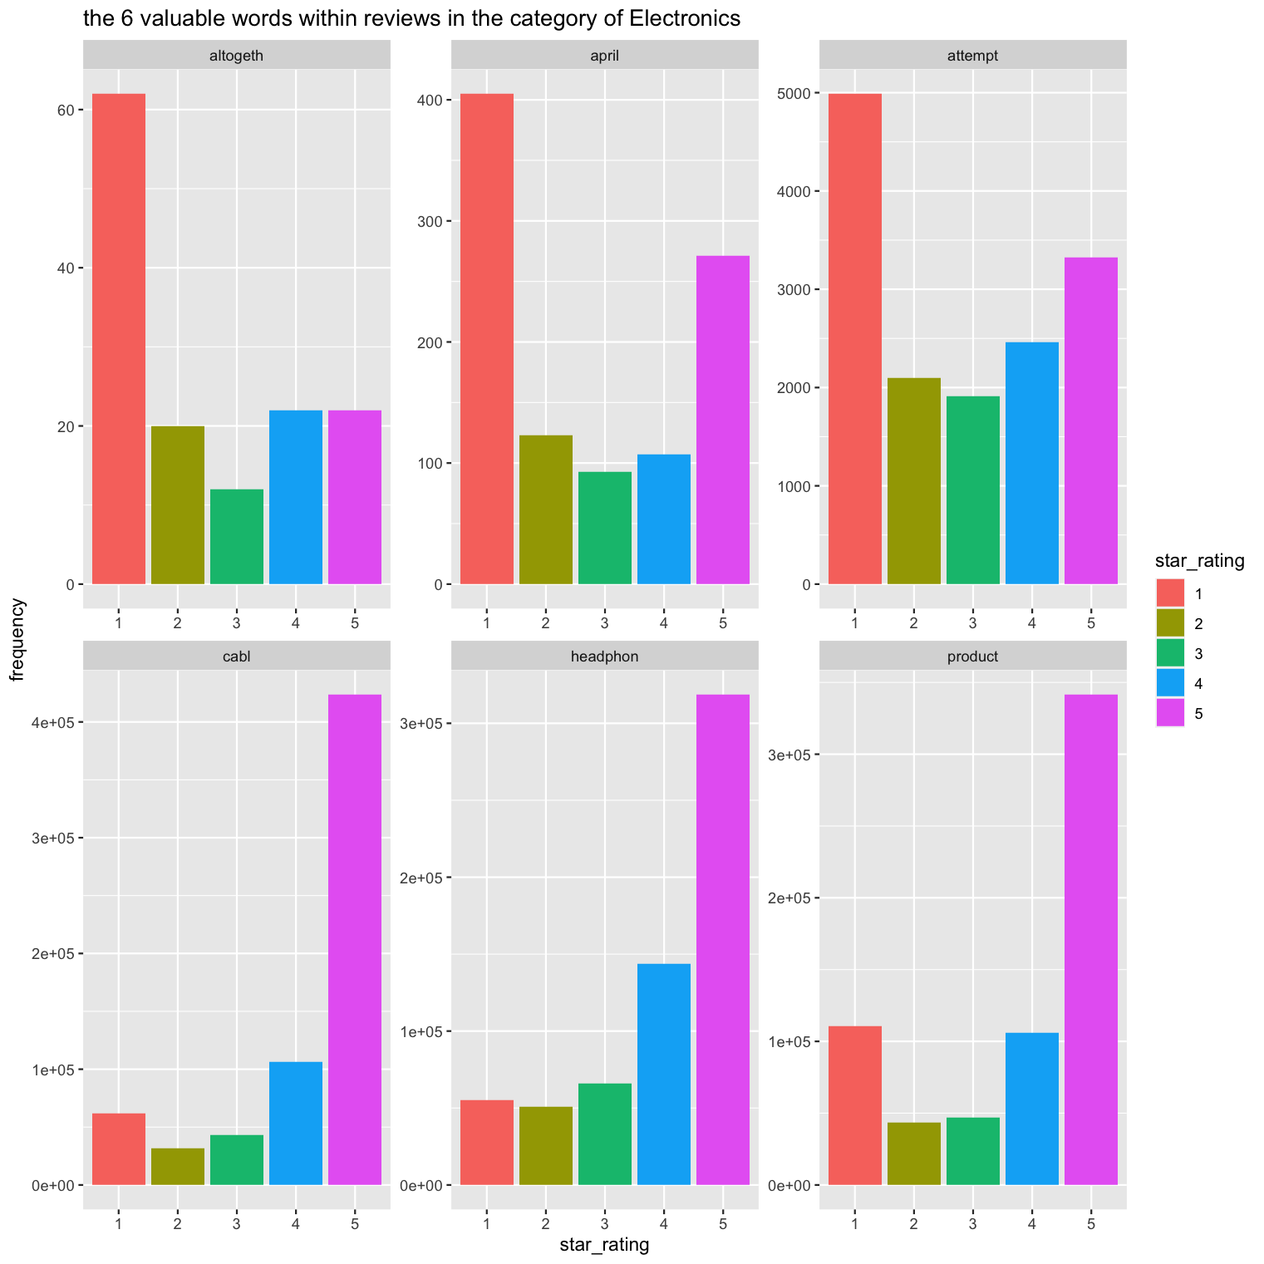
Conclusion
Data Processing
Example:
We split the camera.tsv (1.1GB) into 11 small tsv files.
After that, we run word_freq_array_camera.sh to launch 11 small jobs. Each job does the tokenization and lemmatization to each csv file, and then calculates the frequency of each word, returning a csv file with Column word, star_ratings, and frequency.
Then, a bash file named merge.sh merges all these csv files about camera into one csv file.

Slide 15
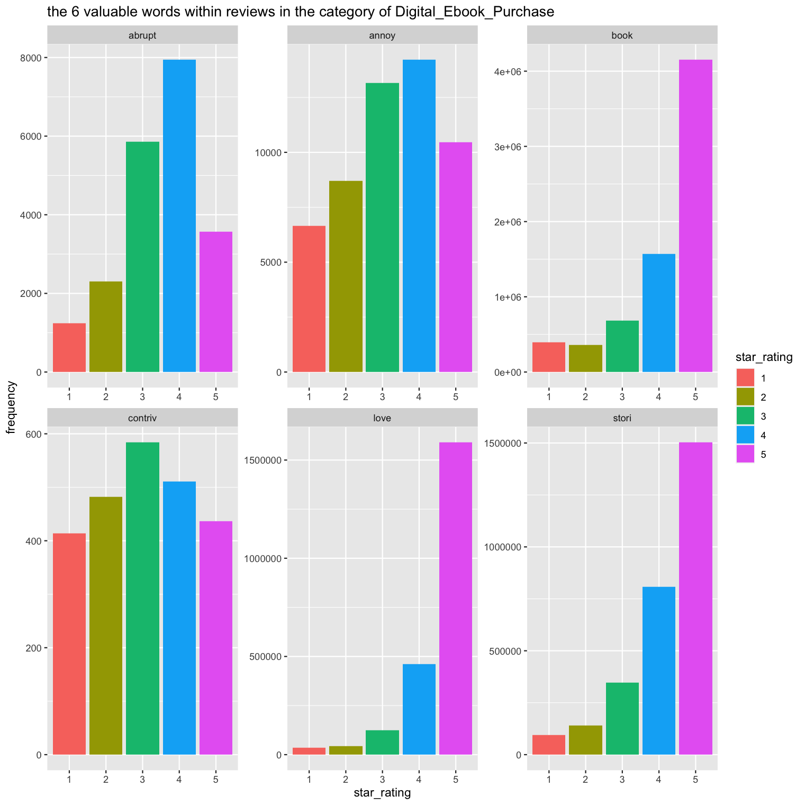
Conclusion
Data Processing
Example:
We split the camera.tsv (1.1GB) into 11 small tsv files.
After that, we run word_freq_array_camera.sh to launch 11 small jobs. Each job does the tokenization and lemmatization to each csv file, and then calculates the frequency of each word, returning a csv file with Column word, star_ratings, and frequency.
Then, a bash file named merge.sh merges all these csv files about camera into one csv file.

Slide 16
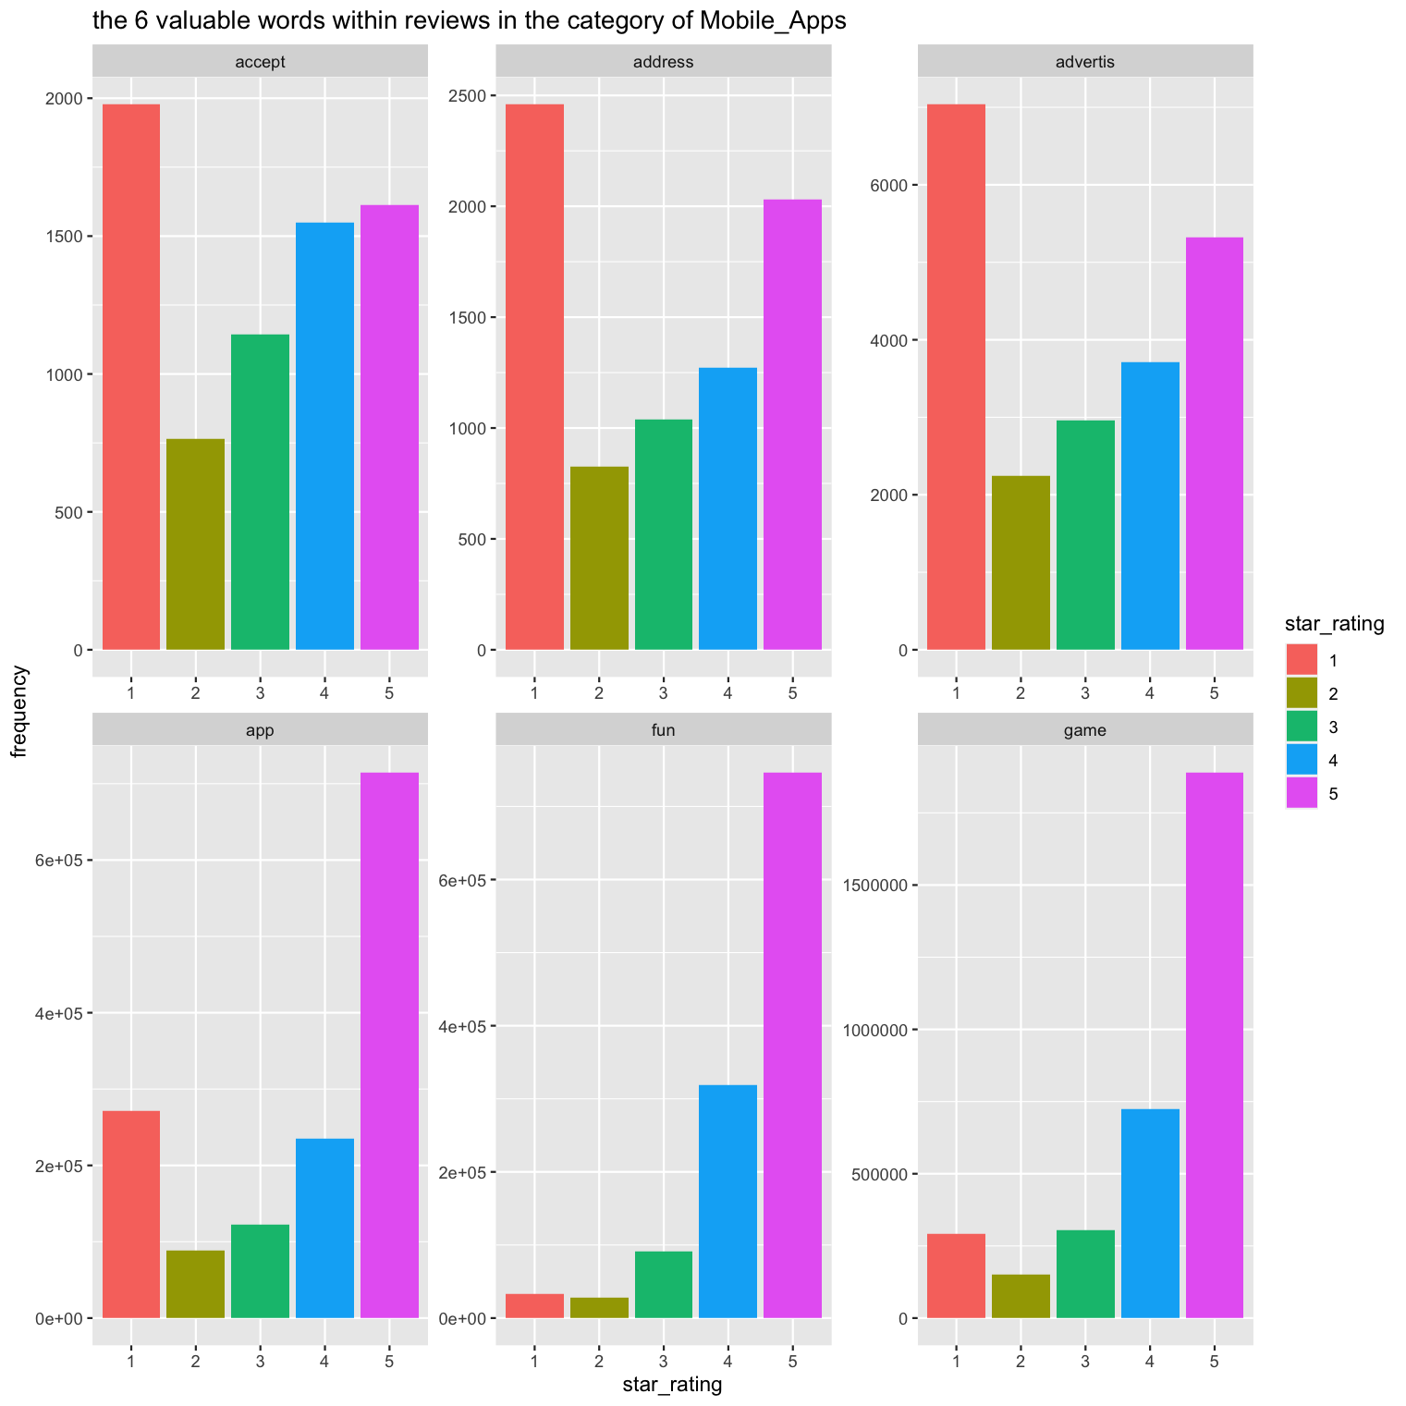
Conclusion
Data Processing
Example:
We split the camera.tsv (1.1GB) into 11 small tsv files.
After that, we run word_freq_array_camera.sh to launch 11 small jobs. Each job does the tokenization and lemmatization to each csv file, and then calculates the frequency of each word, returning a csv file with Column word, star_ratings, and frequency.
Then, a bash file named merge.sh merges all these csv files about camera into one csv file.

Slide 17

THANKS

